Slide 1

Thermo-Mechanical Response of
Cr₂₀Fe₂₀Nb₃₀Ti₃₀ Medium Entropy Alloy (MEA)
Name- Gaurav Kumar Yadav
Entry no- 2025MMM1001
M.TECH. in Metallurgical and materials engineering (2025-2027)
Supervisor : Dr. Nitish Bibhanshu
Co-supervisor : Dr. Suman Mishra

Slide 2
Introduction:
High-Entropy Alloys (HEAs) are a class of advanced metallic materials containing multiple principal elements, offering unique combinations of mechanical and functional properties.
The Cr–Fe–Nb–Ti alloy system is of significant interest due to the strong influence of its constituent elements on phase stability, microstructure, strength, and deformation behaviour.
In the present study Cr₂₀Fe₂₀Nb₃₀Ti₃₀ alloy is investigated to understand the relationship between its composition, phase constitution, microstructure and mechanical properties.
The composition selection is based on the role of each element. Titanium and Niobium are major constituent because Ti has lowest density (4.51g/cm³), high strength, and good high temperature capability while Nb has a high melting point (1670 °C) thus is useful to high temperature strength and thermal stability. Cr and Fe are minor constituent because Cr is mainly added for oxidation and corrosion resistance while Fe is relatively economical transition element and contributes to solid-solution strengthening and structural stability.

Slide 3
Cr₂₀Fe₂₀Nb₃₀Ti₃₀ High Entropy Alloys (HEAs), prepared by arc melting under a high-purity argon gas atmosphere.
The alloy is characterized using X-ray Diffraction (XRD), Energy-Dispersive Spectroscopy (EDS) and Electron Backscatter Diffraction (EBSD) to investigate its phases, elemental distribution, grain structure, and crystallographic characteristics.
Hot Compression testing at different temperatures and different Strain Rates is done to evaluate the alloy's strength and deformation behaviour response.
The study aims to establish a microstructure–mechanical property relationship and understand the factors governing the deformation behaviour of the Ti₃₀Nb₃₀Fe₂₀Cr₂₀ alloy.

Slide 4
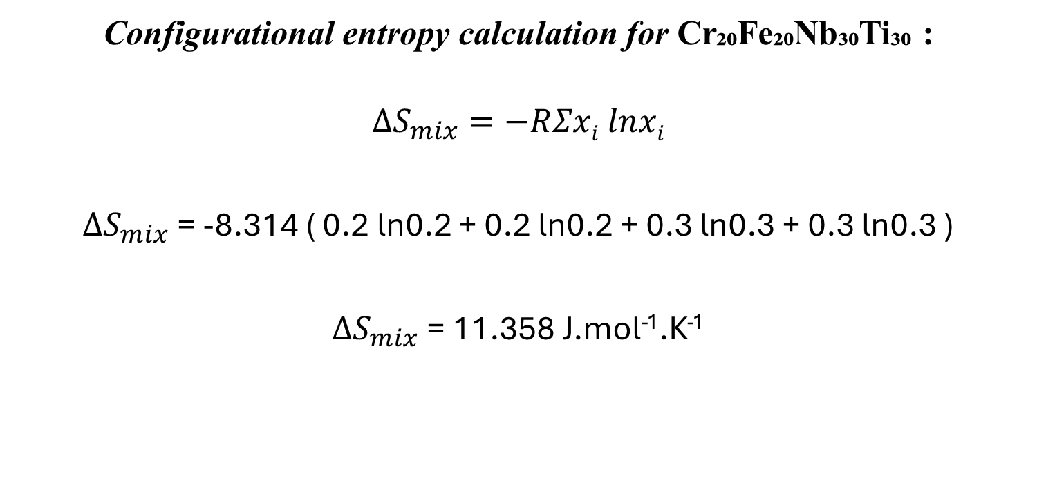
Configurational entropy calculation for Cr₂₀Fe₂₀Nb₃₀Ti₃₀ :
$$ΔS_{mix}=−RΣxi lnxi$$
$ΔS_{mix}$= -8.314 ( 0.2 ln0.2 + 0.2 ln0.2 + 0.3 ln0.3 + 0.3 ln0.3 )
$ΔS_{mix}$= 11.358 J.mol⁻¹.K⁻¹

Slide 5
Research Objective:
To investigate the thermo-mechanical response of Cr₂₀Fe₂₀Nb₃₀Ti₃₀ under high-temperature deformation conditions.
To study the effect of temperature on the compressive deformation behaviour of the alloy.
To evaluate the effect of strain rate on flow stress, strength and deformation behaviour at elevated temperatures.
To establish the relationship between microstructure and mechanical properties using XRD, EBSD, EDS and optical microscopy also corelate with Hardness.
To identify suitable temperature and strain-rate conditions for achieving desirable mechanical performance and deformation behaviour.

Slide 6
Applications: The Cr₂₀Fe₂₀Nb₃₀Ti₃₀ alloy can be investigated for potential applications where high-temperature mechanical stability and resistance to deformation are important such as:
Aerospace and propulsion components exposed to elevated temperatures
High-temperature structural components in energy and power-generation systems.
Automotive and engine components requiring elevated temperature strength.
High-temperature Punch and dies subjected to mechanical and thermal loading.
Gas turbine components and power generation systems.
Wear and corrosion resistant components.
Advanced manufacturing and thermo-mechanical processing where deformation at different temperatures and strain rates is essential

Slide 7
The test which I have performed till now
Compression test at different temperatures and at different strain rates
XRD as Cast sample
EBSD/EDS
The test which we have to perform in future
Optical microscope images.
Corrosion/oxidation test.
Hardness test from centre to periphery

Slide 8
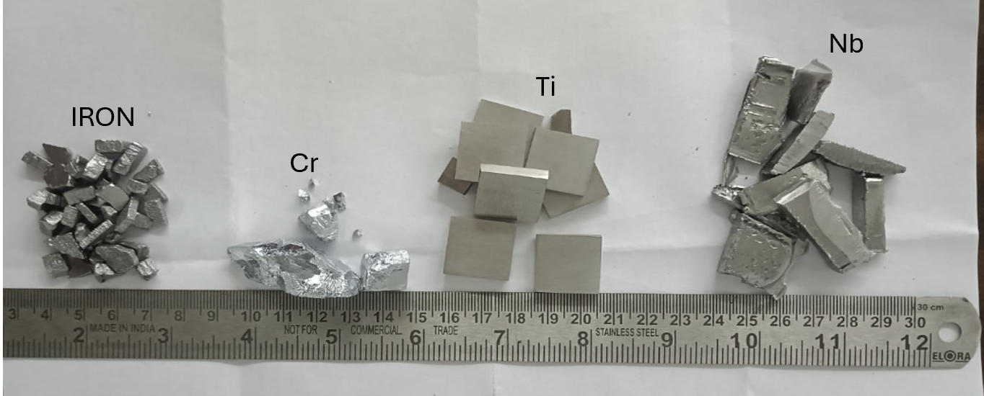
Experimental Works
(1) As Cast Sample preparation
The Cr, Fe, Nb, and Ti raw materials with high purity has mixed in the specific composition: Cr₂₀Fe₂₀Nb₃₀Ti_{30 .}
The purity and form of these materials are listed as:
Cr- pieces,99% purity
Fe-pieces, 99.99% purity
Nb- pieces, 99.8% purity
Ti- pieces, CP titanium

Slide 9
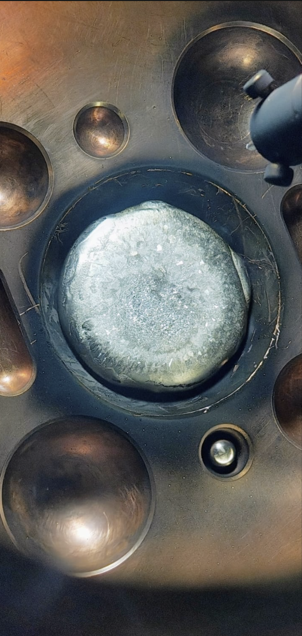
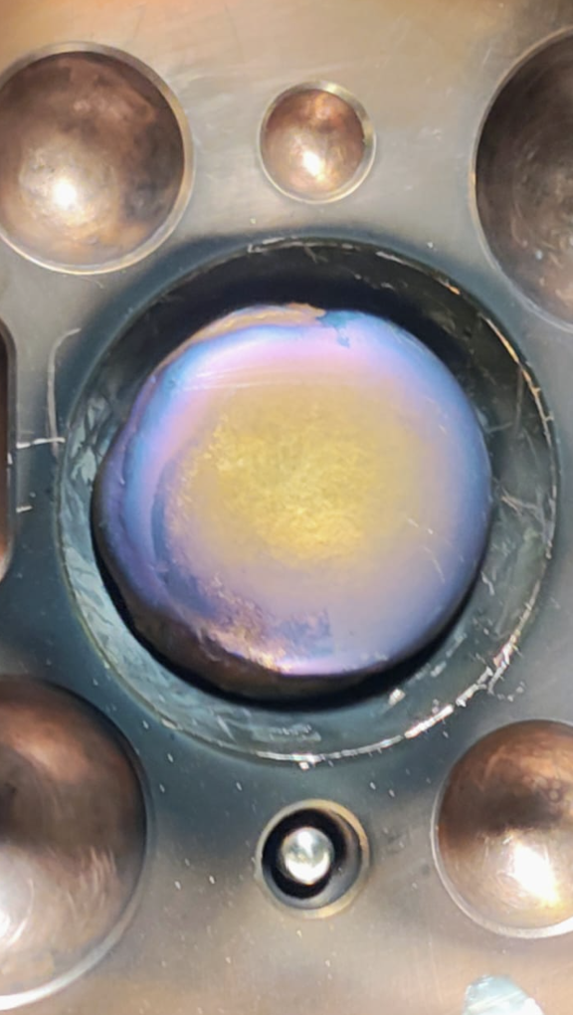
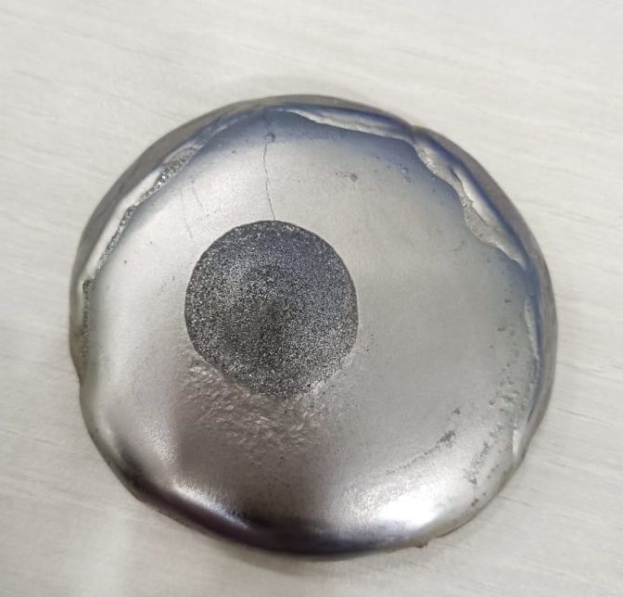
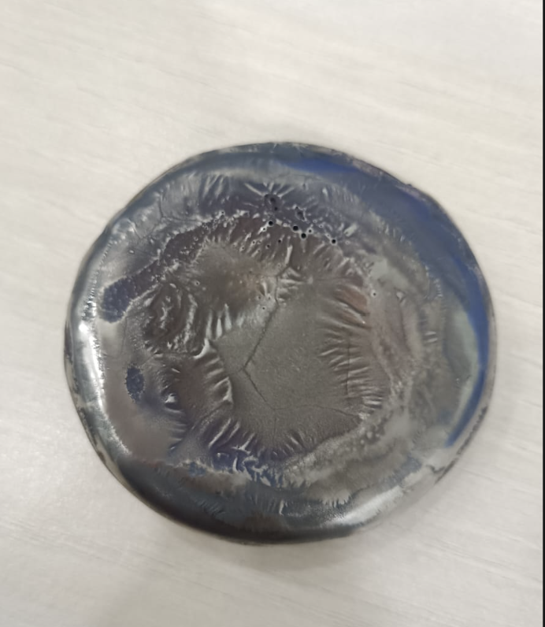
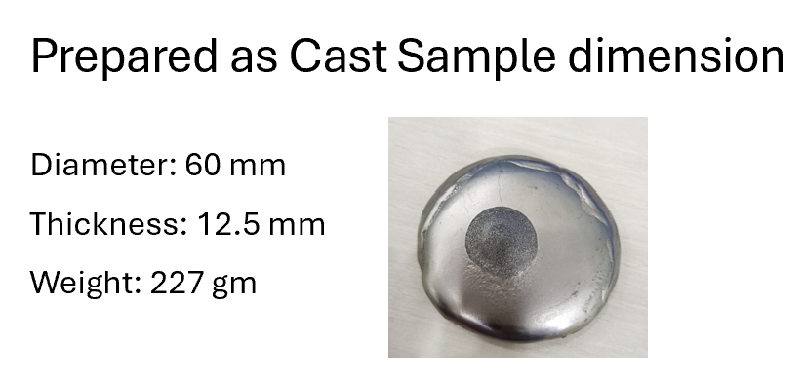
All of these raw materials were Arc-melted under high purity argon gas atmosphere multiple times (8 times) to ensure proper homogenization.
In vacuum arc furnace
After removing from arc furnace

Slide 10
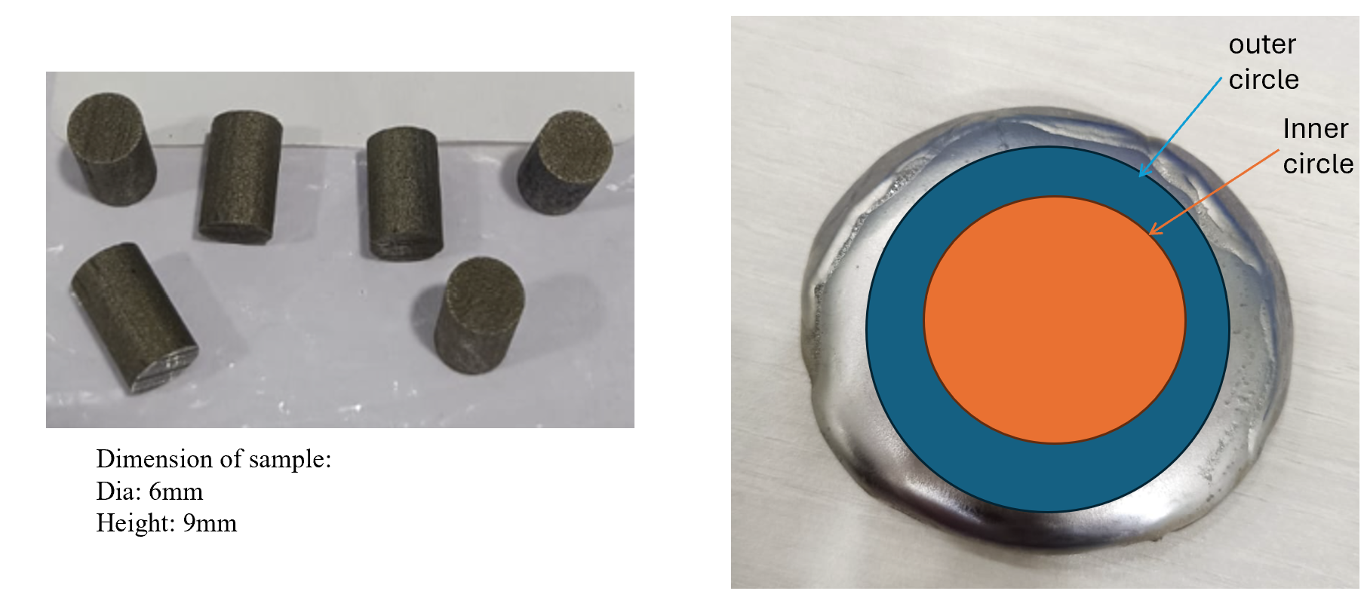
(2) Hot-Compression Testing Experimental Procedure:
As cast Sample which was fabricated by vacuum arc melting in presence of high purity argon gas atmosphere was cut by electric-discharge machining as shown in fig. To produce hot compression cylindrical sample of 9 mm height and 6 mm diameter.
Then the Compression test were performed on DARTEC Hydraulic Universal material testing machine fitted with a high temperature furnace for mechanical testing at elevated temperatures.
DARTEC Hydraulic Universal material testing machine on which compression test were performed having maximum load applying capacity is 100kN.

Slide 11
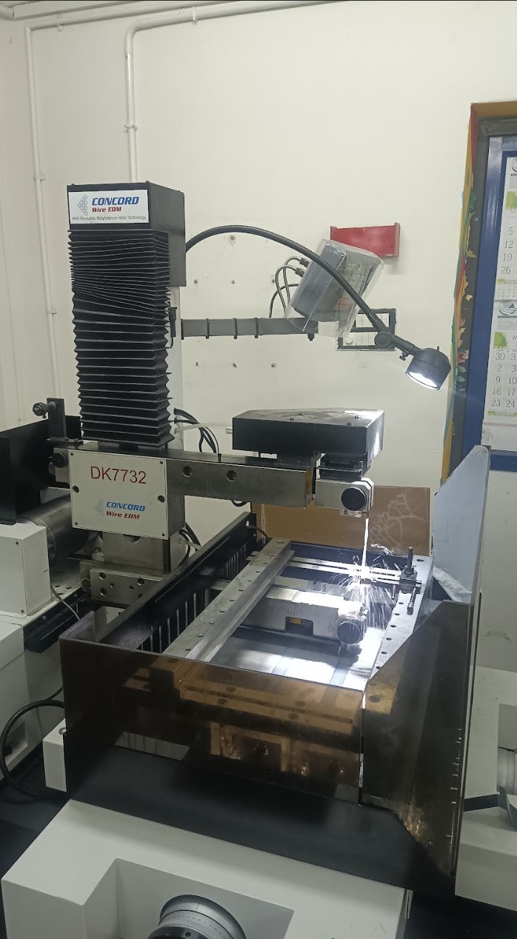
EDM is used for cutting different samples.

Slide 12
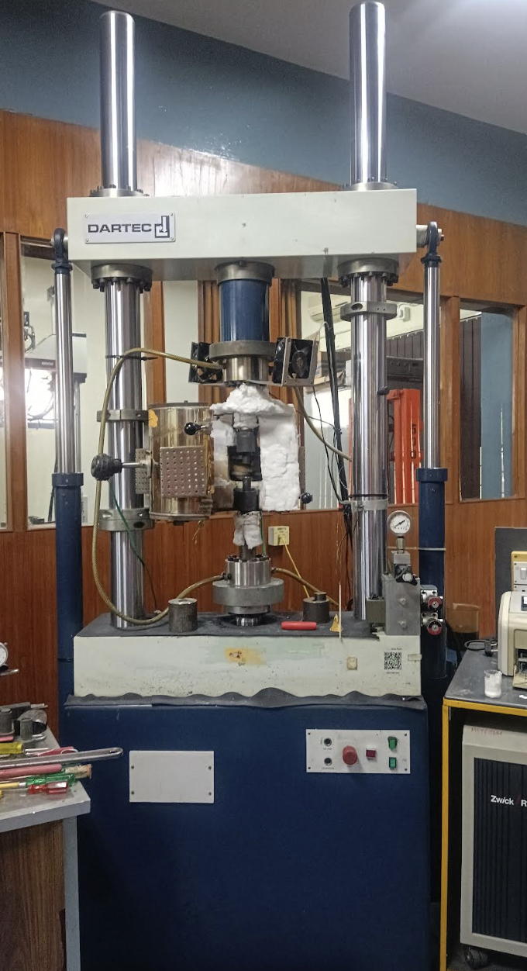
The Compression test were performed on
DARTEC Hydraulic Universal material
testing machine fitted with a high
temperature furnace for mechanical testing
at elevated temperatures.
Its load applying capacity is 100kN.

Slide 13
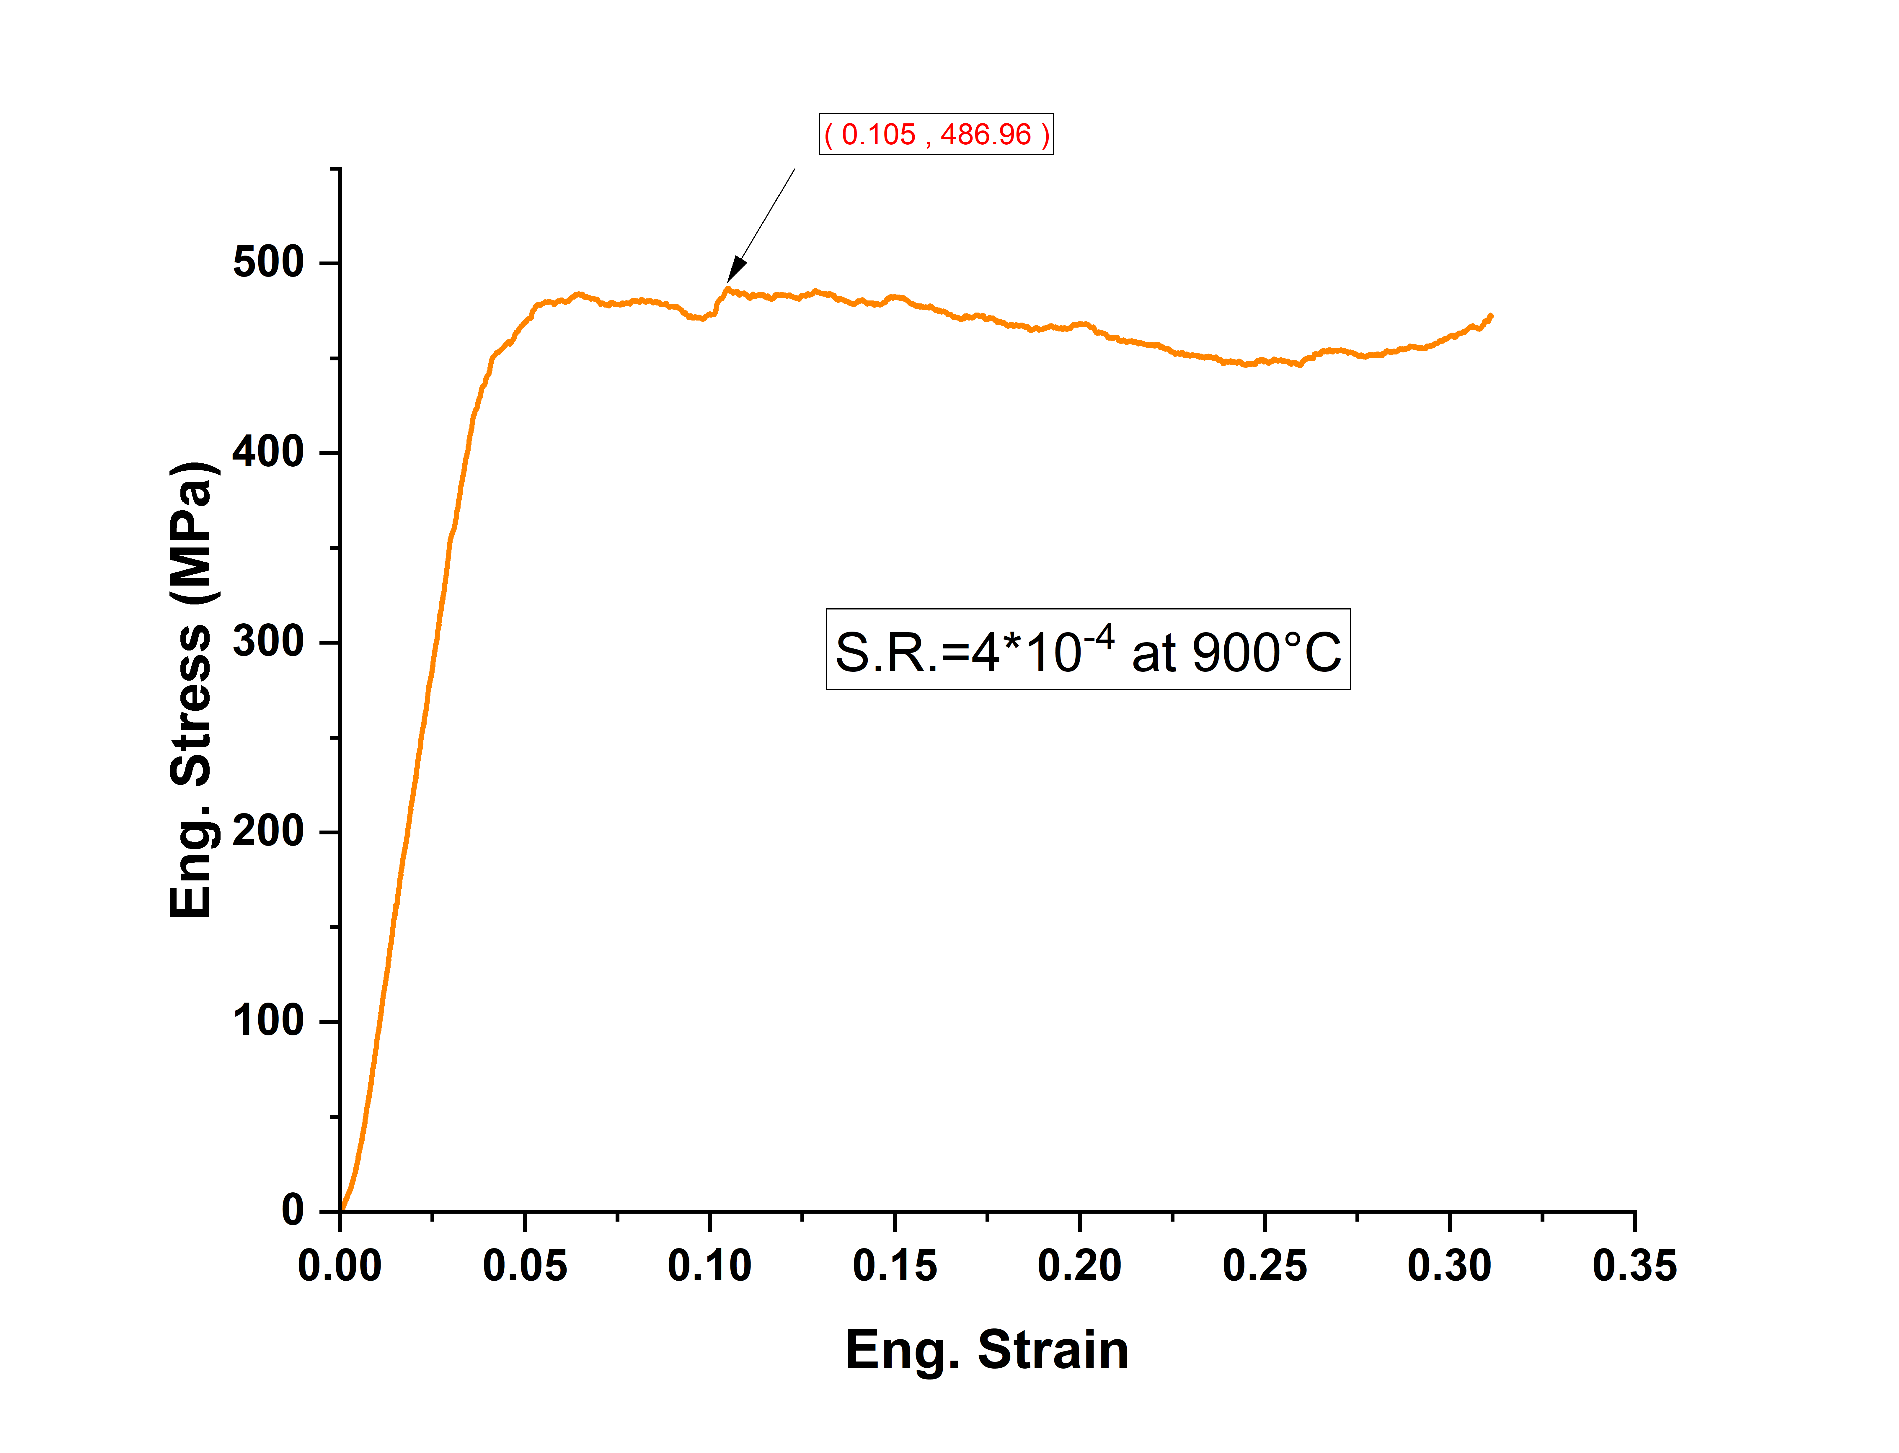
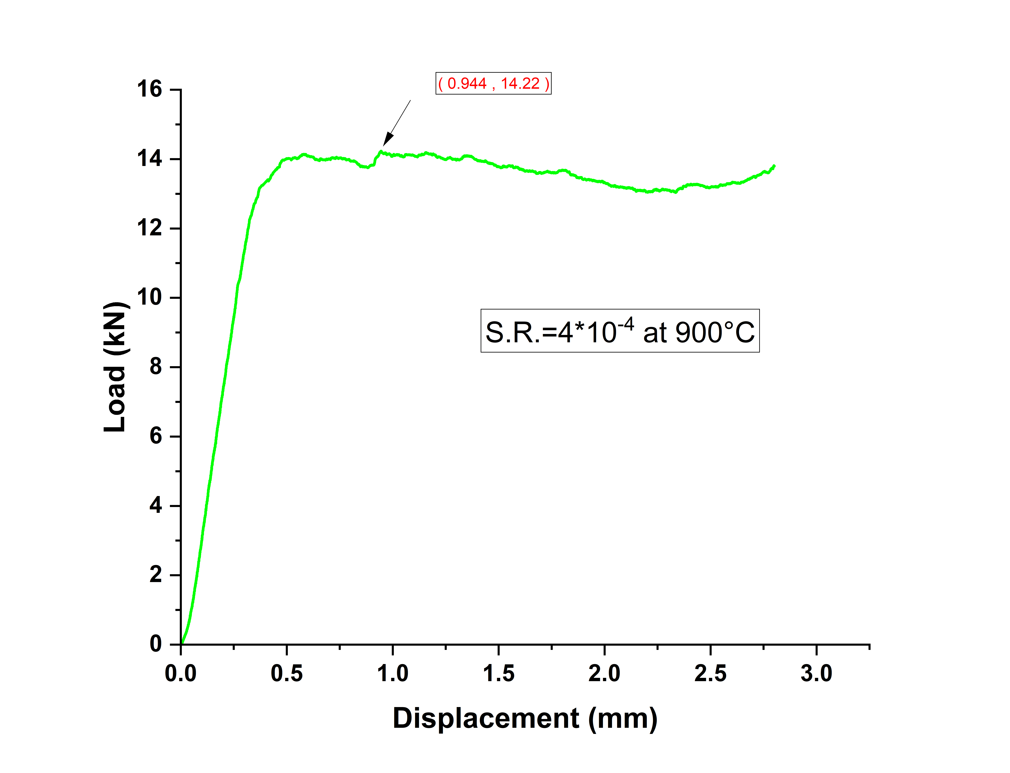
The Load-Displacement and Engineering Stress-Strain Curve of different samples at different Strain rates and different Temperatures

Slide 14
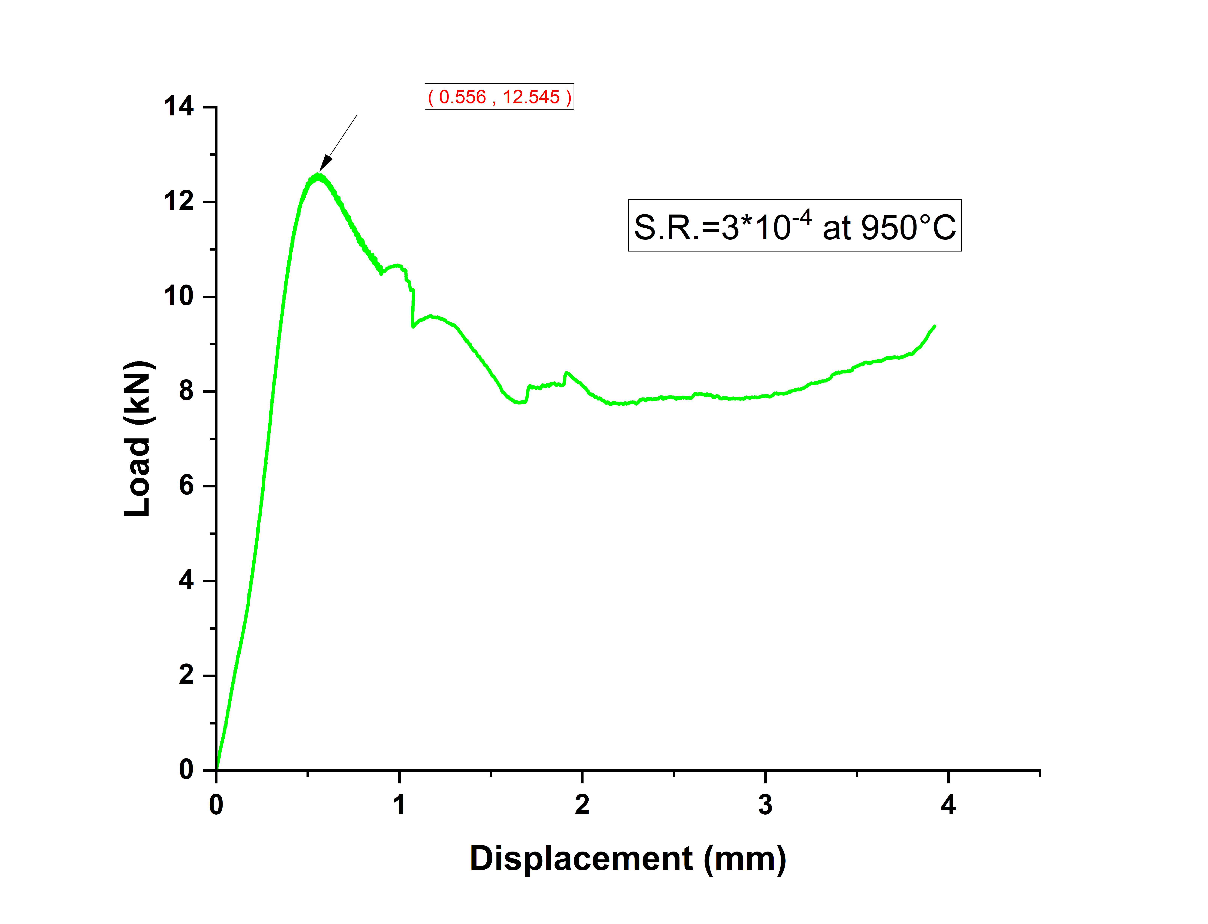
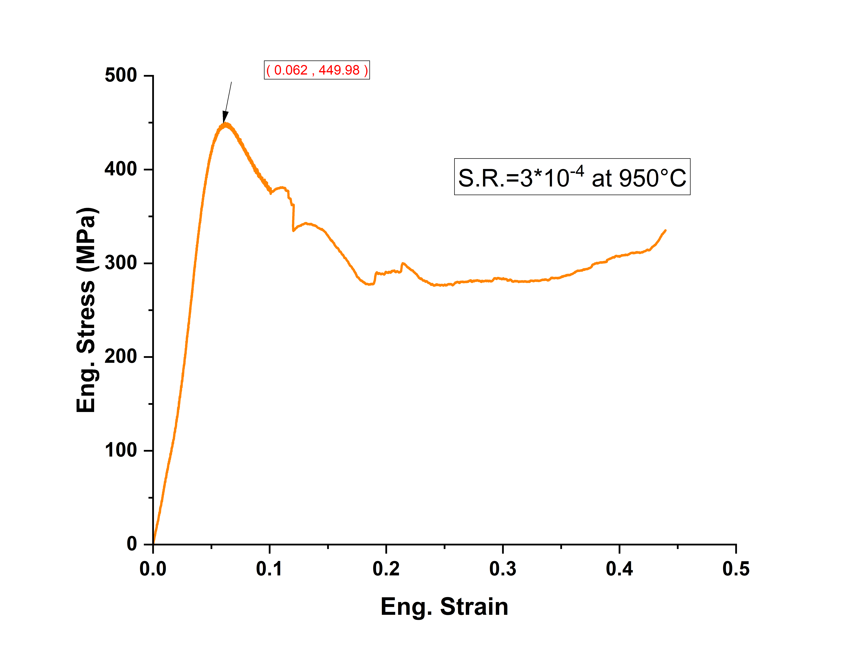

Slide 15
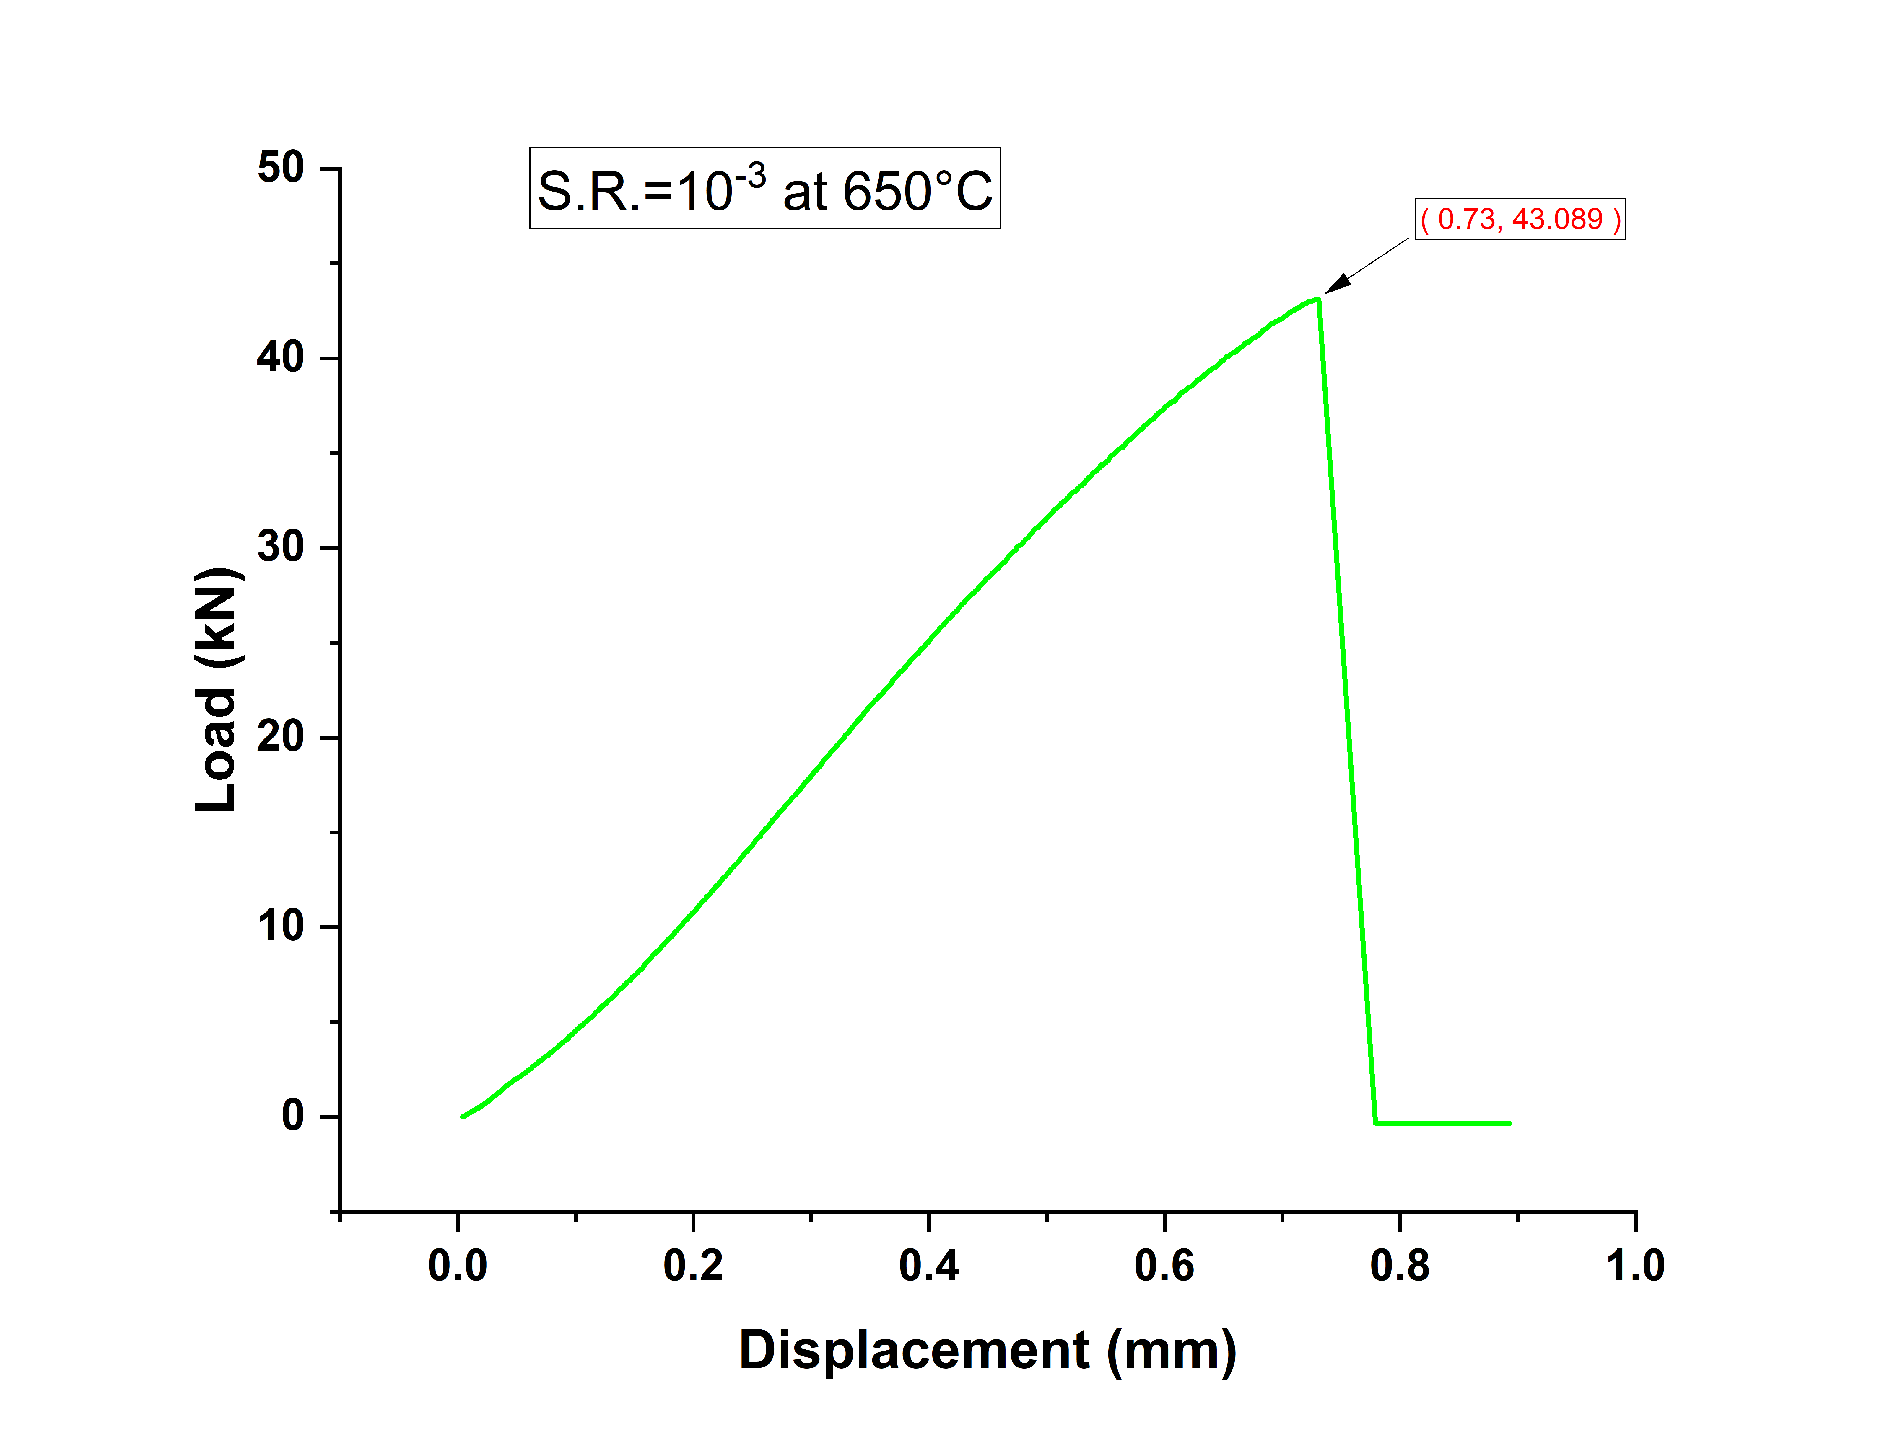
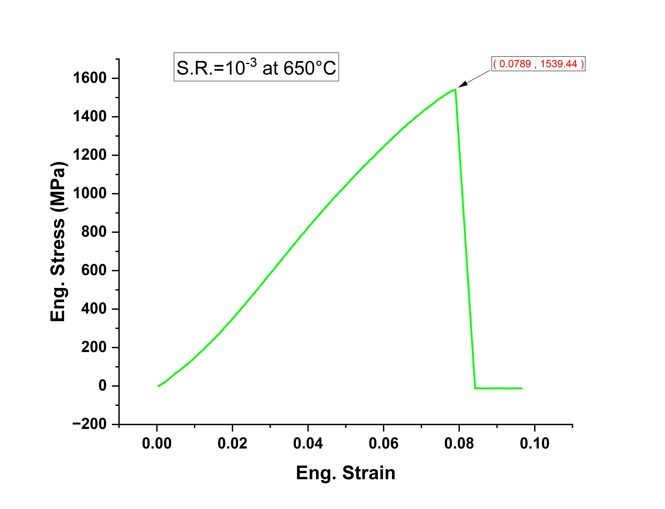

Slide 17
Equation | y = a + b*x
Plot | Eng. Stress
Weight | No Weighting
Intercept | -10.93182 ± 0.54629
Slope | 16432.77412 ± 37.20559
Residual Sum of Squares | 55.32073
Pearson's r | 0.99982
R-Square (COD) | 0.99964
Adj. R-Square | 0.99963

Slide 19
Equation | y = a + b*x
Plot | Eng. Stress
Weight | No Weighting
Intercept | -2.90828 ± 0.50861
Slope | 16696.99487 ± 31.33434
Residual Sum of Squares | 782.36111
Pearson's r | 0.99973
R-Square (COD) | 0.99945
Adj. R-Square | 0.99945

Slide 23
Comparison of Mechanical Behaviour at Different Strain Rates and Different Temperatures :
S.N. | Strain Rate (S⁻¹) | Temperature(°C) | Peak Load (kN) | Displacement (mm) | Peak Flow Stress (MPa) | strain
1 | 3*10-4 | 900 | 14.22 | 0.944 | 486.96 | 0.105
2 | 3*10-4 | 950 | 12.545 | 0.556 | 449.98 | 0.062
3 | 10⁻³ | 650 | 43.089 | 0.73 | 1539.44 | 0.0789
4 | 10⁻³ | 850 | 30.38 | 0.534 | 1039.94 | 0.0595
5 | 10⁻³ | 900 | 18.68 | 0.462 | 639.44 | 0.051
6 | 10⁻³ | 950 | 17.447 | 0.522 | 623.54 | 0.058
7 | 10⁻² | 900 | 31.46 | 4.45 | 1076.8 | 0.497
8 | 10⁻² | 950 | 19.14 | 4.474 | 655.1 | 0.499
9 | 10⁻¹ | 900 | 25.76 | 4.35 | 881.48 | 0.4856
10 | 10⁻¹ | 950 | 20.83 | 4.02 | 712.76 | 0.446

Slide 24
Effect of Mechanical Behaviour on changing Temperatures at Fixed
Strain Rate 10⁻³
Effect of Mechanical Behaviour on changing Temperatures at Fixed
Strain Rate 10⁻³

Slide 26
Observations from The Graph at fix strain rate and varying temperature:
From the above graph we can clearly observe that as
At lower temperature : Stress is high
At higher temperature: Stress is Lower
So from the graph we clearly observe that as Temperature is increasing Flow Stress is decreasing.
Why does temperature decreases the Flow stress ?
At high temperature atoms have higher thermal energy therefore process such as dislocation motion , dislocation climb , dynamic recrystallization , grain-boundary process can occur more easily . Therefore the materials offers less resistance to deformation so as
Temperature ↑ ⟹ Stress ↓

Slide 27
Effect of Mechanical Behaviour on changing Strain Rate at Fixed Temperature (900°C)

Slide 29
Effect of Mechanical Behaviour on changing Strain Rate at Fixed Temperature (950°C)

Slide 30
Observations from The Graph at fix temperature and varying strain rate :
From the above graph we can clearly observe that as
At lower Strain Rate : Stress is lower
At higher Strain Rate : Stress is higher
So from the graph we clearly observe that as Strain Rate is increasing Flow Stress is also increasing.
Why does Strain Rate increases the Flow stress ?
At higher strain Rate the material has less time for recovery , diffusion , dislocation rearrangement and dynamic recrystallization therefore more resistance to deformation is occur so as
Strain Rate↑ ⟹ Flow Stress↑

